Slide 1
The Dark Knight
2008

Slide 2
LOG SET UP/SCREENING NOTES
Elements of film noir | Examples from film

Slide 3
DISCUSS
You seemed enthusiastic about wanting to watch this film. Why? Did it live up to your expectations? How/how not?
In the movie, people refer to the caped crusader as “The Batman.” What is the difference in referring to him as merely “Batman” vs. “The Batman”?
One article suggests that Batman is the SIDEKICK to the Joker. Harvey says, “You either die a hero or live long enough to see yourself become the villain.”
Joker says, “Nobody panics when things go ‘according to plan.’ Even if the plan is horrifying!”

Slide 4
Log Response 1
Is this neo-noir? Develop a substantial answer to look both at what does seem to categorize the movie as a modern form of film noir as well as what is missing that would then prevent one from calling it neo-noir.

Slide 5
Select a video option to view.
See teacher page for files.

Slide 6
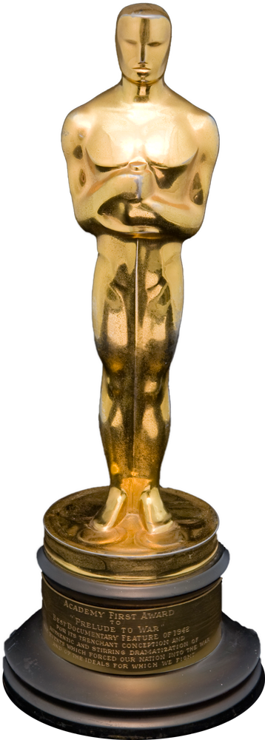
Final Log Response-Select 1
Did Heath Ledger deserve the posthumous Oscar? Why/Why not? Reference the film and the extra video you selected to watch. Note—here’s whom he beat:
A.
B.
If you’ve seen Joker, compare/contrast Joaquin Phoenix’s Joker to Heath Ledger’s. Note that Phoenix has already won the Golden Globe, and he is nominated for an Oscar. Who played the part better?

Slide 7
Extra exploration, if there’s time…
See next slides/teacher page

Slide 8
Read Sources 1 and 2--Discuss
Is Gotham/The Joker reminiscent of a post-9/11 world? Is director Christopher Nolan capturing a “modern anxiety” in this film? How so? Or not? Is he being exploitive?
Do these sources change your mind about The Dark Knight as neo-noir?
What was something from one of the sources that seemed far-fetched to you?

Slide 9
Watch The Dark Knight Rises clips, then read Sources 3 and 4

Slide 10
DISCUSS Sources 3 and 4
What additional elements of film noir do you see addressed in the clips and/or sources?
What “modern anxiety” does Nolan seem to be capturing in The Dark Knight Rises?
If the trilogy were extended to a tetralogy, what modern anxiety do you think Nolan could work to capture?

